Slide 1

Tutorial

Slide 2










Various Deep Learning Toolkits

Slide 3
Deep Learning Toolkits Trend

Slide 4
Deep Learning Toolkits Trend

Slide 5
Chapter 1: Tensor
TensorFlow 2 Tutorial
Chapter 1
Tensor
Tensor

Slide 6
Chapter 1: Tensor
Tensor Creation
Tensor Operation
Shape of Tensor
Indexing of Tensor
Tensor Broadcasting
Ragged and Sparse Tensor
Tensor Implementation
Tensor

Slide 7
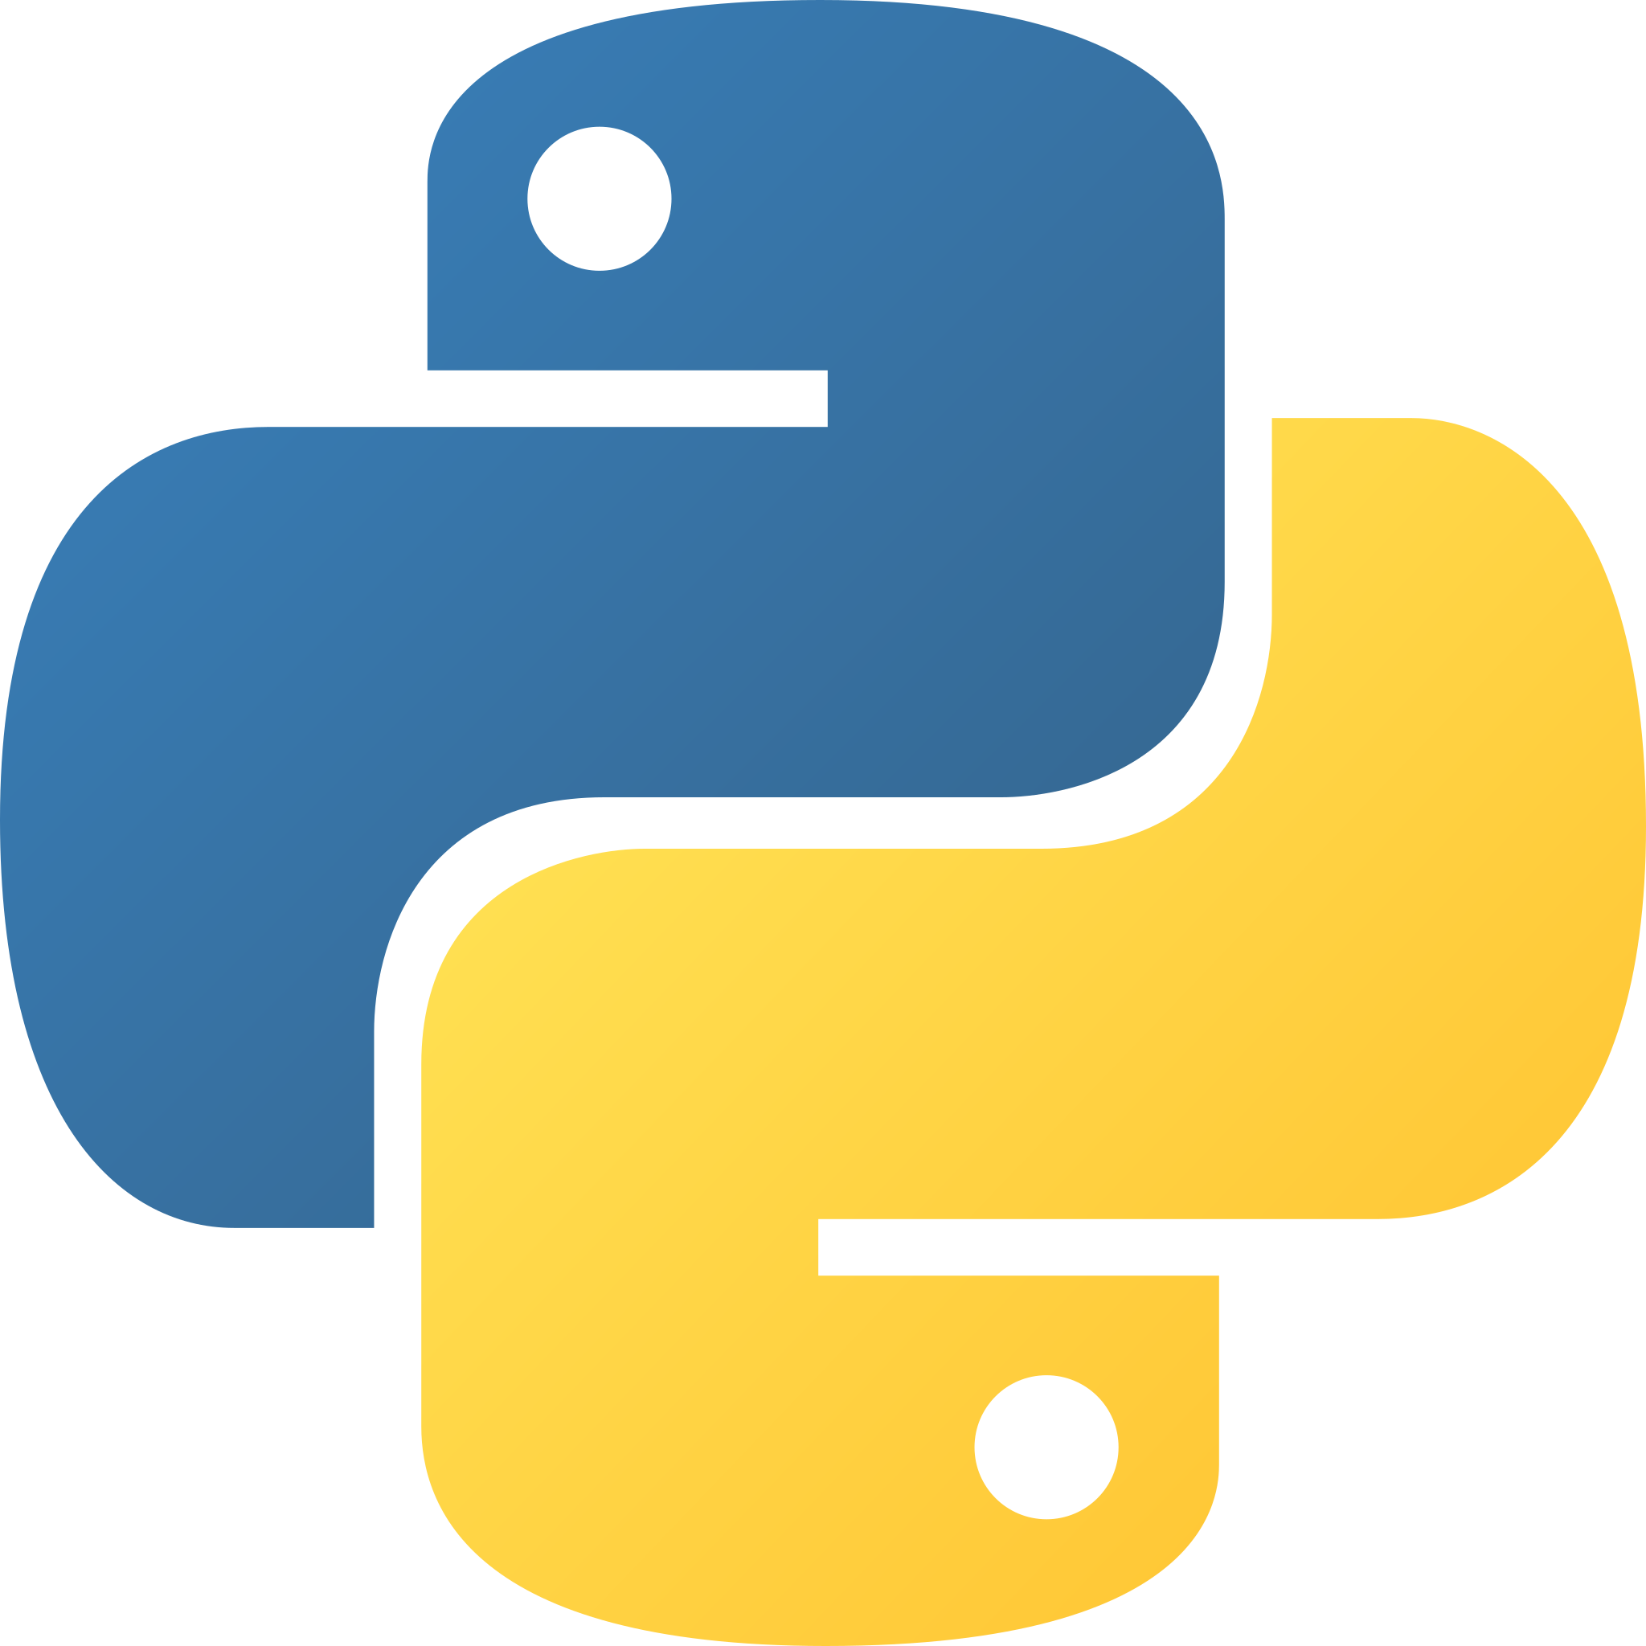
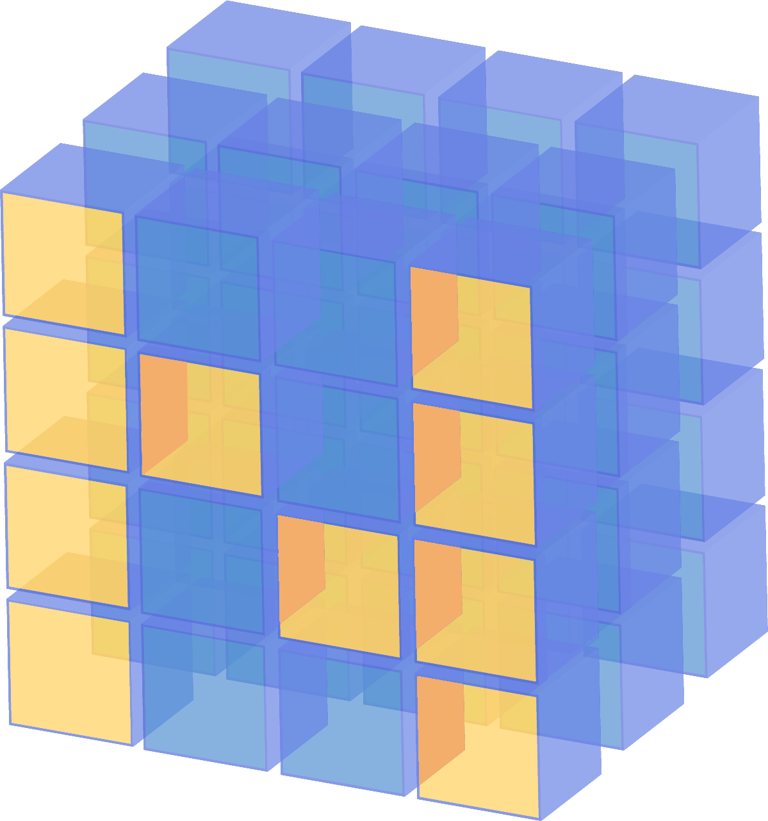
Container
Python
Numpy
Tensorflow 2
list
tuple
dict
ndarray
Tensor

Slide 8
Tensor Creation
import numpy as np
import tensorflow as tf
# Input a scalar
x = tf.constant(1.2)
tf.print(x)
# Input an object of Python list type
x = tf.constant([2, 3.2, 4])
tf.print(x)
# Input an object of Python tuple type
x = tf.constant((1, 2, 3))
tf.print(x)
# Input a ndarray of Numpy
x = tf.constant(np.array([1, 2, 3]))
tf.print(x)
Create a Tensor object from data
tf.constant

Slide 9
Special Tensor

Slide 10
Container
x = tf.constant([1, 2, 3, 4])
x = np.array([1, 2, 3], dtype=np.float32)
x = tf.constant(np.array([1, 2, 3]))
x = np.array([1, 2, 3]).tolist()
x = tf.constant([1, 2, 3]).numpy()

Slide 11

Chapter 2: Datasets
TensorFlow 2 Tutorial
Chapter 2
Datasets

Slide 12

Chapter 2: Neural Networks
TensorFlow 2 Tutorial
Chapter 3
Neural Networks

